Slide 1



InstruNet AI
CNN-Based Music Instrument Recognition System
End-to-End Audio Analysis and Instrument Detection using Deep Learning
Presented By: K. Surya Teja

Slide 2
Table of Contents
  Problem Statement
  Dataset and Challenges
  System Architecture
  Model and Pipeline
  Results
  UI and Deployment
  Conclusion & Future Scope

Slide 3
Problem Statement
  Identifying instruments in a music track is crucial for tasks such as audio tagging, remixing, indexing, and recommendation systems. Manual labeling of instruments is time consuming and error-prone.
  InstruNet AI aims to automatically detect instruments in a music track using Convolutional Neural Networks (CNNs) applied to audio spectrograms.

Slide 4
Dataset and Challenges
Dataset Characteristics
  The Instrument classes present in the dataset are cello, clarinet, flute, acoustic guitar, electric guitar, organ, piano, saxophone, trumpet, violin, and human singing voice.
  The dataset is split into 2 parts: the training and the testing parts. The audio samples are present in .wav format.
  The training part consists of 6705 samples and the testing part consists of 2874 audio samples.

Slide 5
Dataset and Challenges
Challenges
  Training data is single labelled with the samples of 11 different instruents, while testing data is polyphonic with samples of more than one instrument
  There is a high class imbalance across instruments making a highly important challenge to be addressed
  There are overlapping timbral characteristics between instruments like acoustic guitar and electric guitar

Slide 6
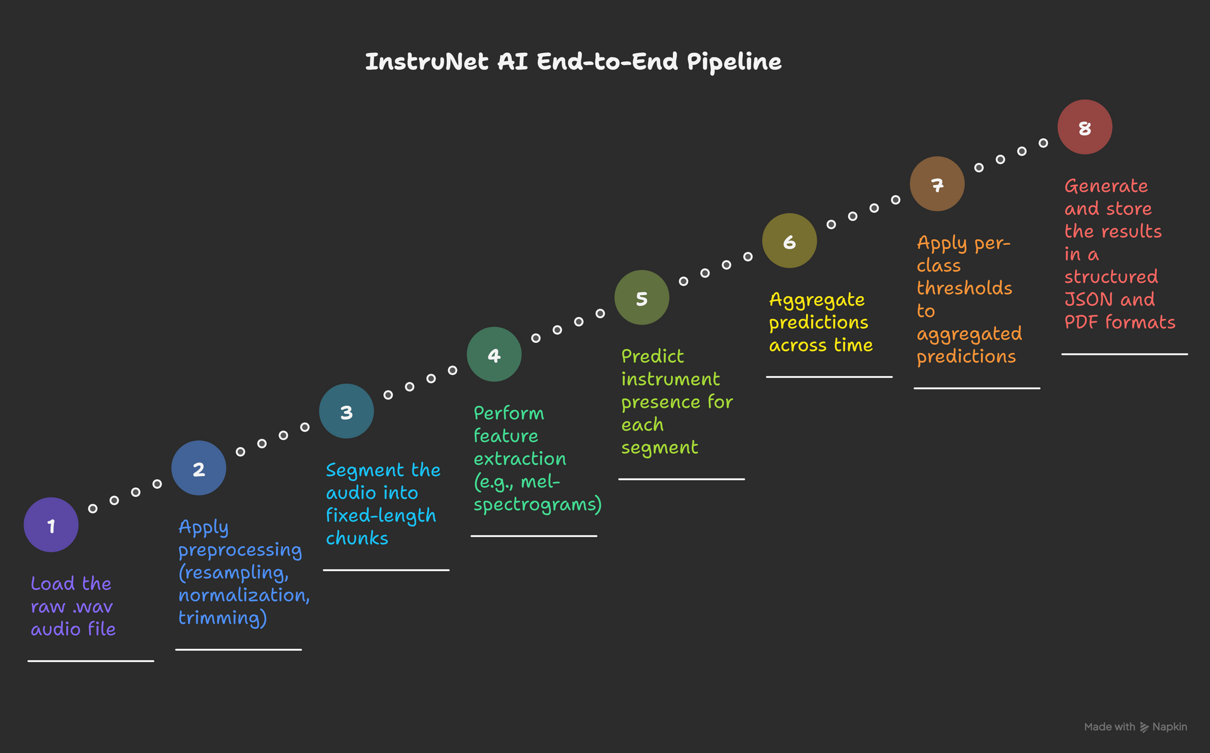
System Architecture

Slide 7
Model and Pipeline
Audio Pipeline
  Stereo to mono conversion
  Resampling to 16 kHz
  Silence trimming and normalization
  Segmentation into 3-second windows with 50% overlap
Model
  CNN trained on log-mel spectrograms
  Multi-label classification using Sigmoid activation and Binary Cross Entropy loss function
  Regularization (L2, Dropout) for better generalization

Slide 8
Results
Model Performance
  Evaluated using Micro F1-score, Macro F1-score, and ROC-AUC
  Temporal aggregation improved stability and reduced false positives
Outcome
  Reliable detection of multiple instruments
  Confidence-based outputs aligned with human perception
  Consistent clip-level predictions from segment-level inference

Slide 9
UI and Deployment
Streamlit Application
  Secure session-based login
  Audio playback, waveform, and spectrogram visualization
  Clear detected-instrument summary with confidence bars
Exports
  JSON: Structured, machine-readable results
  PDF: Human-readable report with interpretation
UX Principles
  No raw tensors shown and thresholds hidden from UI
  Clear separation of input and output

Slide 10
Conclusion and Future Scope
Conclusion
  Successfully built an end-to-end audio ML system from dataset to deployment
  Combined deep learning with interpretability and user-centric design
Future Scope
  Transformer-based audio models for long-term temporal learning
  Training on larger and more diverse music datasets

Slide 11
THANK YOU

